Slide 1
Lecture Title:
Mathematical Foundation of Probabilistic-based Classifier: Bayes’ Decision Rule.

Slide 2
Foundation:
Features: These are measurable quantities obtained from the patterns, and the classification task is based on their respective values.
Feature vectors: A number of features constitute the feature vector Feature vectors are treated as random vectors.

Slide 3

The classifier consists of a set of functions, whose values, computed at , determine the class to which the corresponding pattern belongs
Classification system overview
Patterns
sensor
feature
generation
feature
selection
classifier
design
system
evaluation

Slide 4
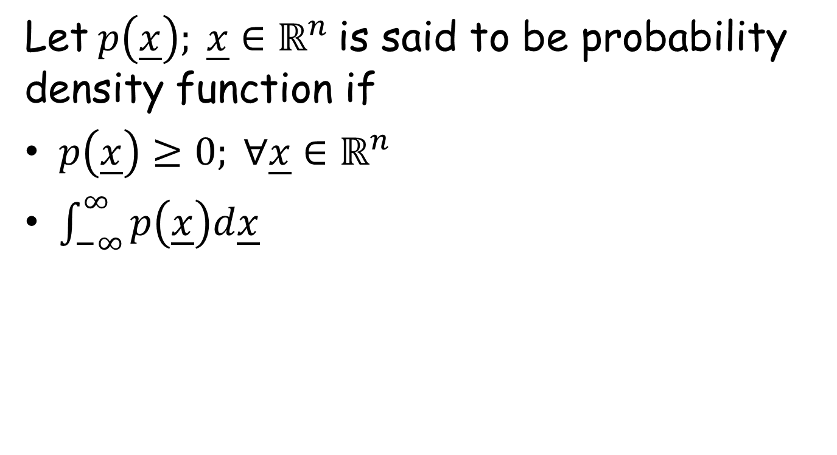
Probability Density Function
Let $p\left(\underline{x}\right); \underline{x}∈ℝ^{n}$ is said to be probability density function if
$p\left(\underline{x}\right)≥0; ∀\underline{x}∈ℝ^{n}$
$\int_{−∞}^{∞}{p\left(\underline{x}\right)d\underline{x}}$

Slide 5
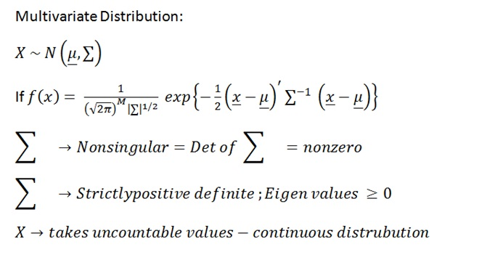
Multivariate Distribution

Slide 6
CLASSIFIERS BASED ON BAYES DECISION THEORY
Statistical nature of feature vectors
Assign the pattern represented by feature vector to the most probable of the available classes That is maximum

Slide 7
Computation of a-posteriori probabilities
Assume known
a-priori probabilities
This is also known as the likelihood of

Slide 8
The Bayes rule (Μ=2)
where

Slide 9
The Bayes classification rule (for two classes M=2)
Given classify it according to the rule
Equivalently: classify according to the rule
For equiprobable classes the test becomes

Slide 10
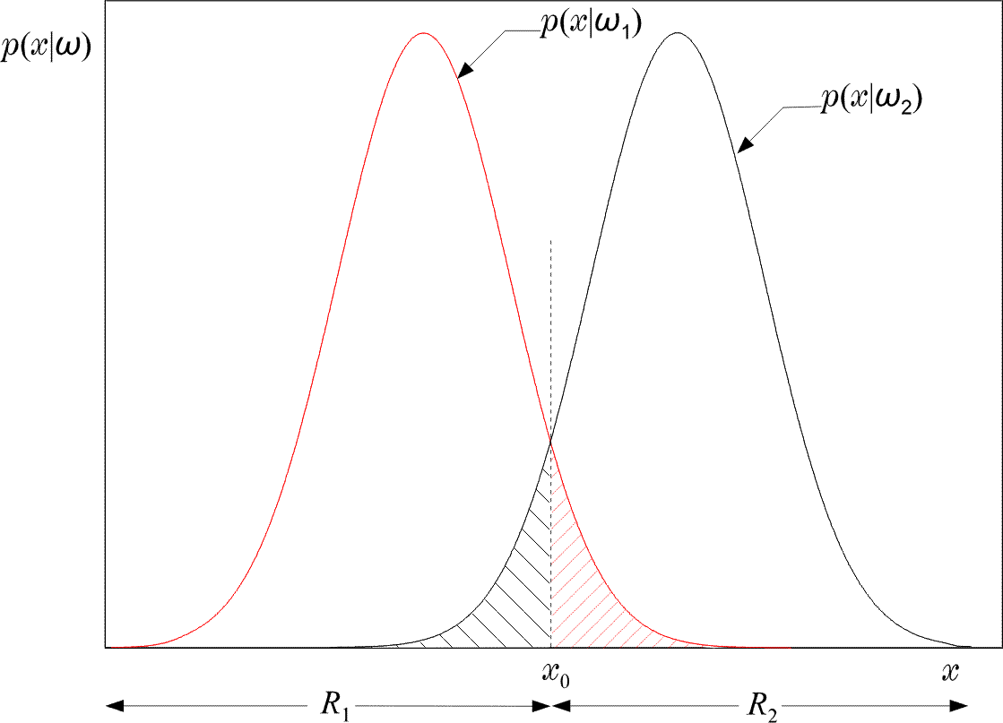
Example of the two regions R1 and R2 formed by the Bayesian classifier for the case of two equiprobable classes.

Slide 11
Equivalently in words: Divide space in two regions
Probability of error
Total shaded area
Bayesian classifier is OPTIMAL with respect to minimizing the classification error probability!!!!

Slide 12
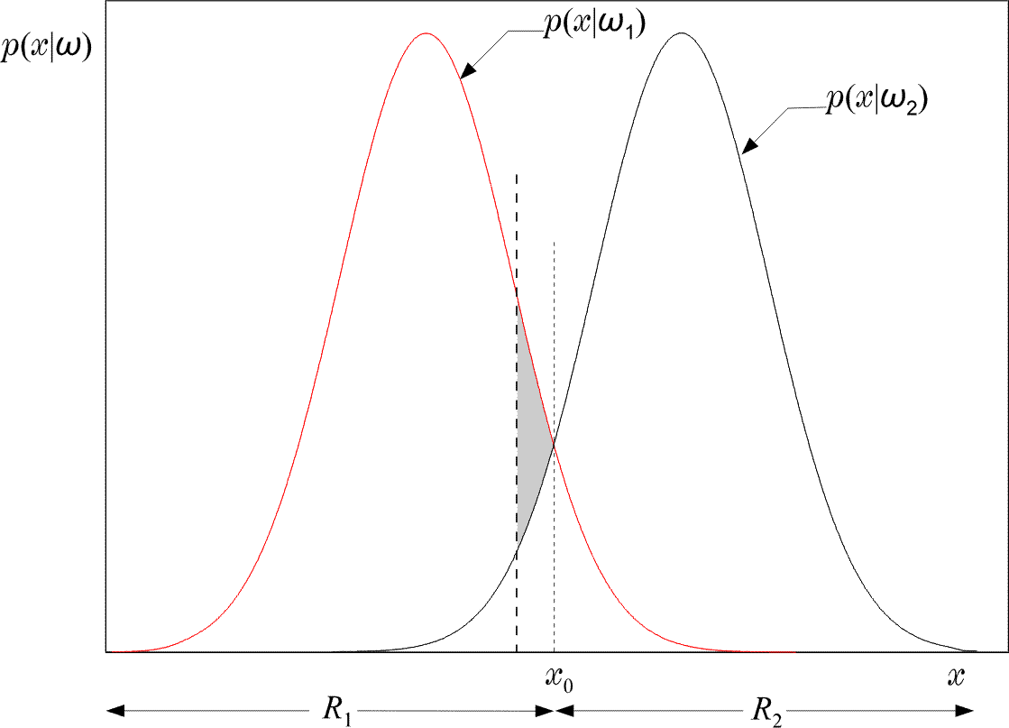
Indeed: Moving the threshold the total shaded area INCREASES by the extra “grey” area.

Slide 13
The Bayes classification rule for many (M>2) classes:
Given classify it to if:
Such a choice also minimizes the classification error probability
Minimizing the average risk
For each wrong decision, a penalty term is assigned since some decisions are more sensitive than others

Slide 14
For M=2
Define the loss matrix
penalty term for deciding class , although the pattern belongs to , etc.
Risk with respect to

Slide 15
Risk with respect to
Average risk
Probabilities of wrong decisions, weighted by the penalty terms

Slide 16
Choose and so that r is minimized
Then assign to if
Equivalently: assign x in if
: likelihood ratio

Slide 17
If

Slide 18
An example:
Compute the threshold value x0 (a) for minimum error probability and
(b) for minimum risk if the loss matrix L is given above

Slide 19
The threshold for
the minimum probability case will be
Then the threshold value is:
Threshold for minimum r
Taking the logarithm of both sides, we end up with x0 = 1/2. In the minimum risk case we get

Slide 20
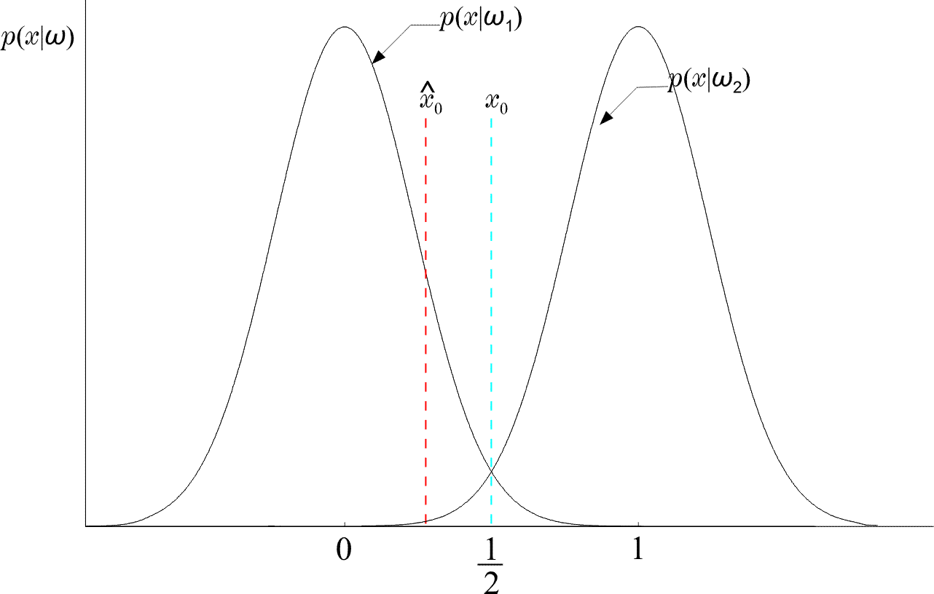
Thus moves to the left of
(WHY?)
If the two classes are
not equiprobable, then it is easily verified that if P(w1) >(<) P(w2) the threshold moves to
the right (left). That is, we expand the region in which we decide in favor of the most probable class, since it is better to make fewer errors for the most probable class.

Slide 21
DISCRIMINANT FUNCTIONS DECISION SURFACES
If are contiguous:
is the surface separating the regions. On one side is positive (+), on the other is negative (-). It is known as Decision Surface
+
-

Slide 22
If f(.) monotonic, the rule remains the same if we use:
is a discriminant function
In general, discriminant functions can be defined independent of the Bayesian rule. They lead to suboptimal solutions, yet if chosen appropriately, can be computationally more tractable.

Slide 23
BAYESIAN CLASSIFIER FOR NORMAL DISTRIBUTIONS
Multivariate Gaussian pdf
called covariance matrix

Slide 24
is monotonic. Define:
Example:

Slide 25
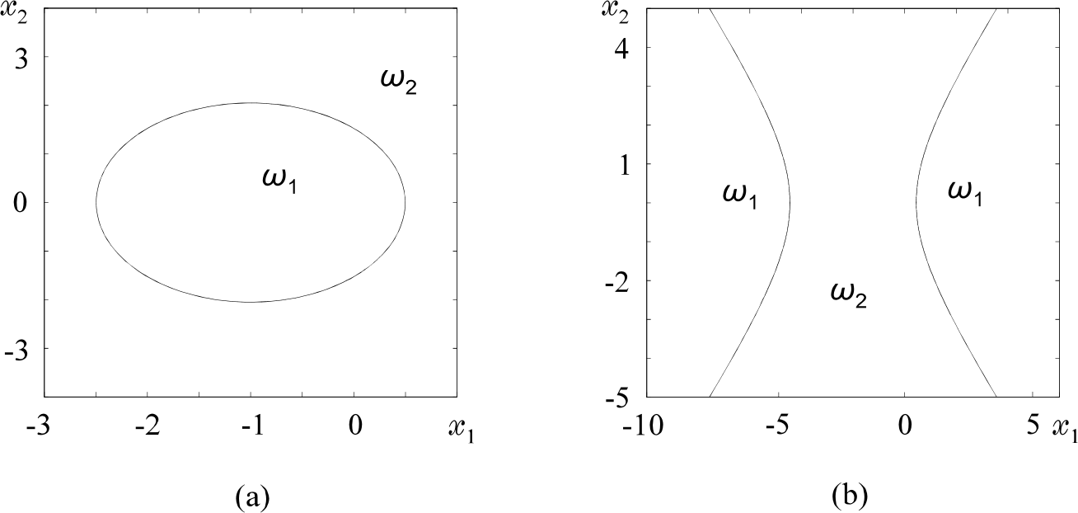
That is, is quadratic and the surfaces
quadrics, ellipsoids, parabolas, hyperbolas, pairs of lines.
For example:

Slide 26
Decision Hyperplanes
Quadratic terms:
If ALL (the same) the quadratic terms are not of interest. They are not involved in comparisons. Then, equivalently, we can write:
Discriminant functions are LINEAR

Slide 27
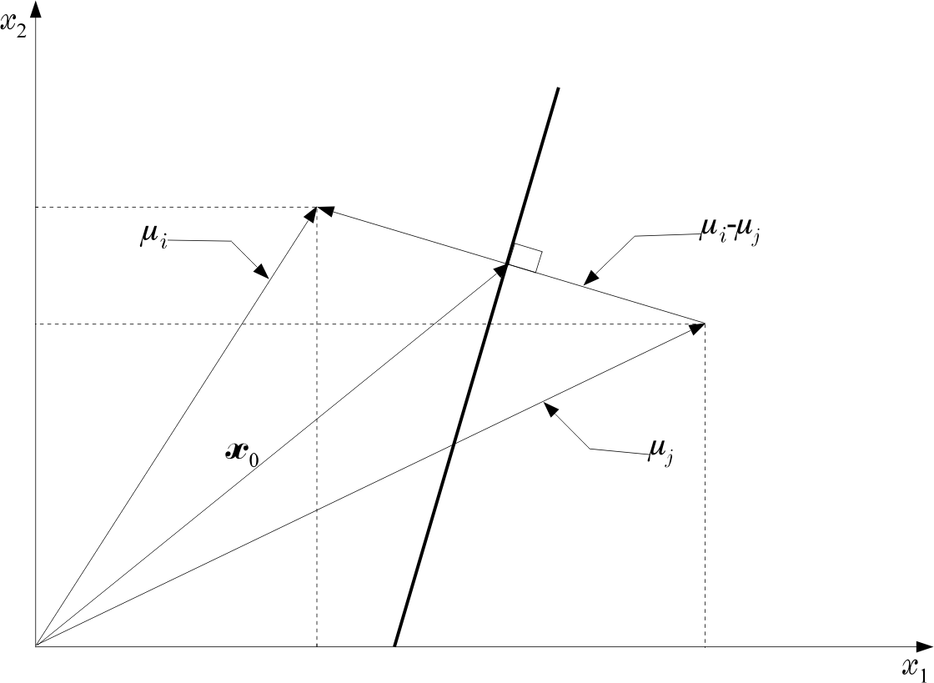
Let in addition:

Slide 28
Nondiagonal:
Decision hyperplane

Slide 29
Minimum Distance Classifiers
equiprobable
Euclidean Distance:
smaller
Mahalanobis Distance:
smaller

Slide 30
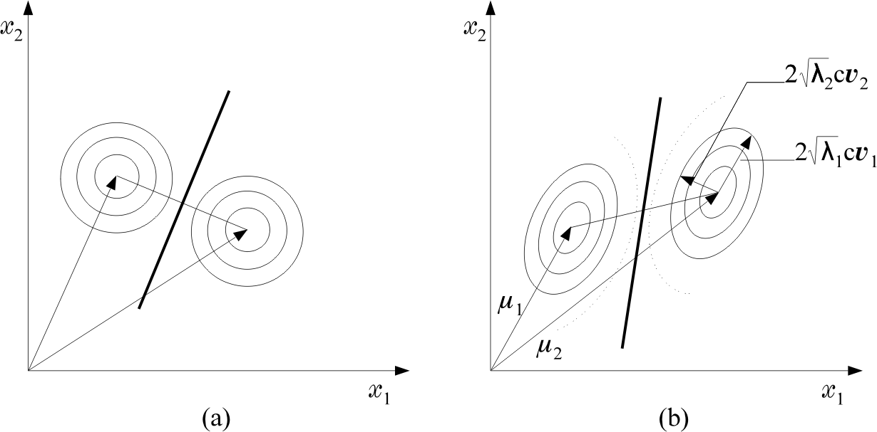

Slide 31
Example:

Slide 32
Practical Implementation on Baye’s Decision Rule

Slide 33
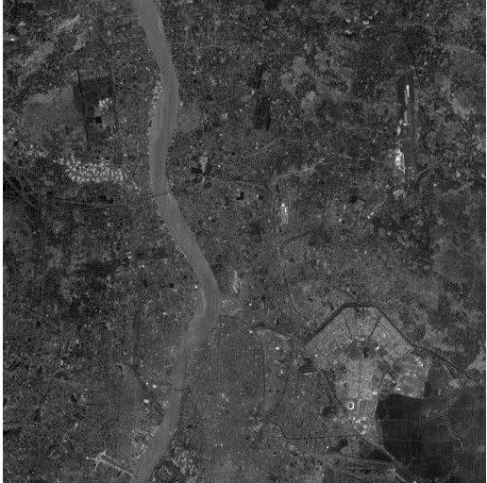
Examples on Satellite images of Kolkata: Given Input Images
R Band Image
(512 * 512)
Photo Courtesy: Prof. C. A. Murthy, Lab, ISI Kolkata

Slide 34
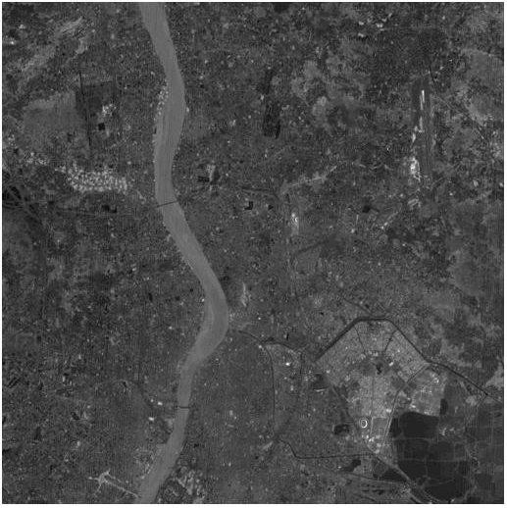
G Band Image
(512 * 512)

Slide 35
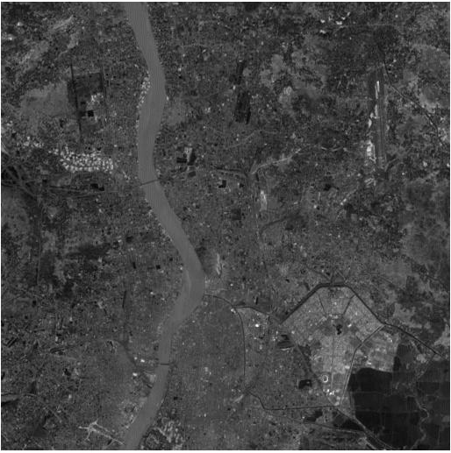
B Band Image
(512 * 512)

Slide 36
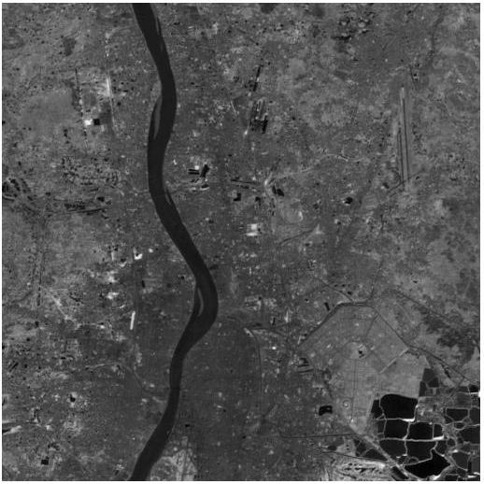
I Band Image
(512 * 512)

Slide 37
Bayes Rule: P1 = 0.3 and P2 = 0.7
Output Image (River Class and Non River Class

Slide 38
Bayes Rule: P1 = 0.7 and P2 = 0.3

Slide 39
Bayes Rule: P1 = 0.5 and P2 = 0.5

Slide 40
How to Implement
Four satellite Images of Kolkata (Rband, Gband, Bband and Iband) are given to you with equal image size (512 * 512).
The feature vector dimension is 4
Each pixel location we have four values.
Two Classes are given (River and NonRiver)
Take 50 sample points (Pixel location’s corresponding pixel values) from river class for training for each band
Take 100 sample points (Pixel location’s corresponding pixel values) from non river class for training for each band.
Take (512 * 512) sample points (Pixel location’s corresponding pixel values) for testing for each band.
Apply baye’s decision rule to classify all the test sample either in river or nonriver class denoting 0 and 255 at corresponding pixel locations.
Show the result in image form with black and white image (either 0 and 255)

Slide 41
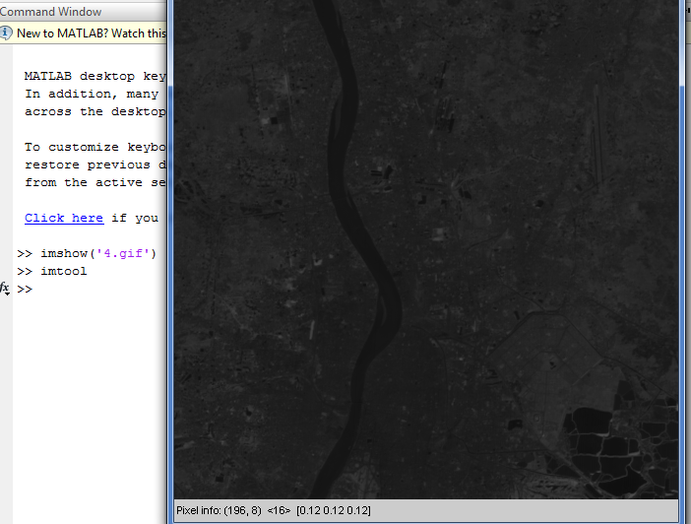
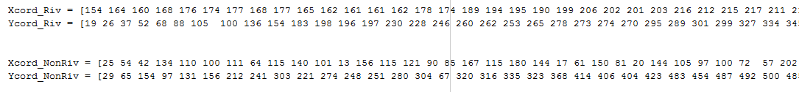
How to choose sample points

Slide 42
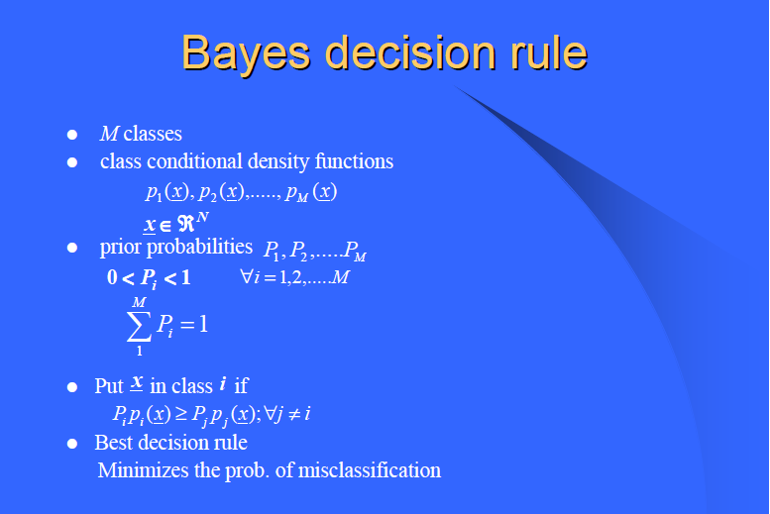

Slide 43
Implementation process of Density Function
Step 1: Calculate Mean of River Class : T1 = [Mean1; Mean2; Mean3 ;Mean4];
Mean1 = mean of Rband image for 50 sample points
Mean2 = mean of Gband Image for 50 sample points
Mean3 = mean of Bband image for 50 sample points
Mean4 = mean of Iband image for 50 sample points
Step 2: Calculate Mean of NonRiver Class : T2 = [Mean1; Mean2; Mean3; Mean4];
Mean1 = mean of Rband image for 100 sample points
Mean2 = mean of Gband Image for 100 sample points
Mean3 = mean of Bband image for 100 sample points
Mean4 = mean of Iband image for 100 sample points
Step 3: Calculate the Covariance Matrix for River Class for 50 samples which is 4 * 4 dimensions. Basically (X – T1) deviation and (Y – T1) deviation and multiply it and summing up
where X and Y represents all the sample points considered for training ( R, G, B and I band image) we will get 2^4 = 16 values in the covariance matrix for possible combinations of 4 band images. We are doing the deviation of sample points from the mean vector.
(Apply covariance matrix calculation formula)

Slide 44
Step 4: Calculate the Covariance Matrix for Non River Class for 100 samples which is 4 * 4 dimensions also by applying same process explained in step 3.
Step 5: Take whole image for test data where : test_data= [Rband_img(i,j) Gband_img(i,j) Bband_img(i,j) Iband_img(i,j)]; i = 1 to 512; and j = 1 to 512;
step 6: The dimension of test data is (4 * (512 X 512));
Step 7: For each pixel location of test image Run the loop from i = 1 to (512 X 512) Do
Step 8: For river class calculate (test_data – T1) deviation and (test_data – T1)^{T} Then Multiply it :
River_class = (Test_data – T1)^{T} * Inverse (Covariance_matrix_Riverclass) *(Test_data – T1)
Step 9: For Non_river class calculate (test_data – T2) deviation and (test_data – T2)^{T} Then Multiply it :
Nonriver class = (Test_data – T2)^{T} * Inverse (Covariance_matrix_NonRiverclass) *(Test_data – T2)

Slide 45
Step 10: Calculate density function p1 for river class where P1 = 0.3 given
p1 = 1/sqrt( Determinant of Covariance_matrix_Riverclass) * exp( -0.5 *River_class);
(Here we apply multivariate Normal Distrubution)
Step 11: Calculate density function p2 for nonriver class where P2 = 0.7 given
p2 = 1/sqrt( Determinant of Covariance_matrix_nonRiverclass) * exp(-0.5 * NonRiver_class);
Step 12: For each pixel location of test image apply baye’s rule (P1 * p1) >= (P2 * p2) then
Out_image(i) = 255 (River class)
Else
Out_image(i) = 0; (Nonriver class)
Step 13 : Goto step 7;
Step 14: Show the three output image Image using imshow function for three cases:
Case 1 : River class (Prior Prob: ) = 0.3 , Nonriver class(Prior Prob) = 0.7
Case 2 : River class (Prior Prob: ) = 0.7 , Nonriver class(Prior Prob) = 0.3
Case 3 : River class (Prior Prob: ) = 0.5 , Nonriver class(Prior Prob) = 0.5

Slide 46
Thank You

